Slide 1
Lecture 6
Entity-Relationship Model (2)

Slide 2
Entity-Relationship Model
Design Process
Modeling
Constraints
E-R Diagram
Design Issues
Weak Entity Sets
Extended E-R Features
Design of the Bank Database
Reduction to Relation Schemas
UML
ER Modeling Process

Slide 3
Weak Entity Sets
A weak entity set does not have a primary key
  Its existence depends on the existence of an identifying entity set
  Identifying relationship set
    A weak entity set must relate to the identifying entity set via a total, one-to-many relationship set from the identifying to the weak entity set
Weak entities are distinguished by the discriminator of the corresponding weak entity set.
  Also known as partial key
To form a primary key …
  the primary key of the identifying entity set, plus the weak entity set’s discriminator.

Slide 4
A Weak Entity Set Example
In a university, a course is a strong entity and a course_offering can be modeled as a weak entity
  The primary key of course is course_number.
  The discriminator of course_offering would be semester (including year) and section_number (if there are multiple sections)
    Or, simply, a sequence number (1, 2, …)
  If we model course_offering as a strong entity, ……
    we would model course_number as an attribute……
    then the relationship with course would be implicit in the course_number attribute

Slide 5

Weak Entity Sets (Cont.)
Notations
  Weak entity set: a rectangle, like a strong entity set, except for two main differences
  Discriminator: underline with a dashed line
  Identifying relationship set: double diamonds
Primary key for section
  (course_id, sec_id, year, semester)

Slide 6
Weak Entity Sets (Cont.)
Note
  The primary key of the strong entity set is *NOT* explicitly stored with the weak entity set, since it is implicit in the identifying relationship.
    If course_id were explicitly stored, section could be made a strong entity set, but then the relationship set between section and course would be duplicated by an implicit relationship set defined by the attribute course_id common to section and course

Slide 7
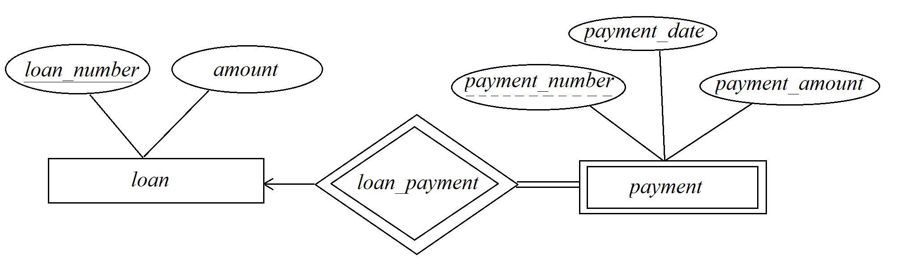
Alternative Notation
A payment is associated with a loan.
  We model “payment” as a weak entity set.
  So what does this mean?

Slide 8
One More Example (and Exercise)
Practice Exercise 6.2
Course
Course Offering
Student
Instructor
Enrollment and grdes

Slide 9
One More Example (and Exercise)
In a social security system, an adult has a primary key (id_card_no), and a minor younger than 16 years old does not have an ID number. Then, minor would be modeled as a weak entity set.
  Any minor has exactly one adult guardian.
  The discriminator of minor may be minor_idx or minor_name
If household registry(户口) is considered, then minors may be related to a household registry.
Now model these……
  Household_Registry(户口)
  Adults (成年人)
  Minors (未成年人)

Slide 10
Extended E-R Features
Specialization
Generalization
Attribute Inheritance
Constraints on Generalizations
  Condition-defined and user-defined lower-level entity sets
  Disjoint and overlapping lower-level entity sets
  Total and partial generalization/specification
Aggregation

Slide 11

Specialization Example

Slide 12
Specialization
A top-down design process
  Designate subgroupings within an entity set that are distinctive from other entities in the set.
These subgroupings become lower-level entity sets that have attributes or participate in relationships that do not apply to the higher-level entity set.
  Also called “ISA” relationship—— Employee is a person
Attribute inheritance
  A lower-level entity set inherits all the attributes and relationship participation of the higher-level entity set to which it is linked.

Slide 13
Generalization
A bottom-up design process
  Combine a number of entity sets that share the same features into a higher-level entity set.
Specialization and generalization are simple inversions of each other
  They are represented in an E-R diagram in the same way.
  The terms specialization and generalization are used interchangeably.
Superclass and Subclass
  Upper-level entity sets and lower-level entity sets, respectively
  The ISA relationship also referred to as superclass-subclass relationship

Slide 14
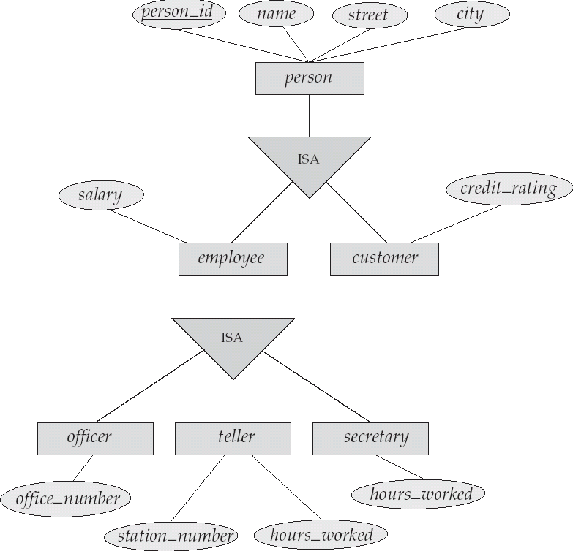
Specialization Example (alt.)

Slide 15
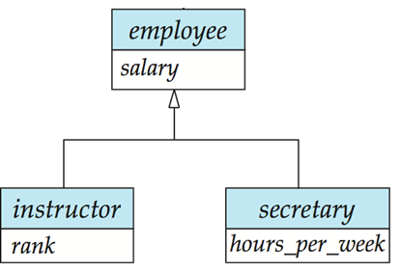
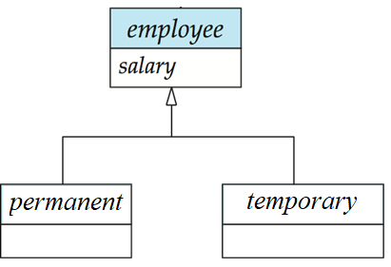
Specialization and Generalization
Can have multiple specializations of an entity set based on different features.
  E.g. permanent_employee vs. temporary_employee, in addition to instructor vs. secretary
  Each particular employee would be
    a member of one of permanent_employee or temporary_employee,
    and also a member of one of officer, secretary, or teller.

Slide 16
Constraints on Generalizations
Constraint on which entities can be members of a given lower-level entity set.
  Condition-defined
    Based on whether or not an entity satisfies an explicit condition or predicate
    Example: all customers over 65 years are members of senior-citizen entity set
      senior-citizen ISA person
      The division is based on attribute age, a defining attribute.
  User-defined
    Employees are assigned to one of four work teams, after three-month novitiate.
    Which to? Decided by someone in charge.

Slide 17
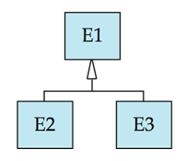
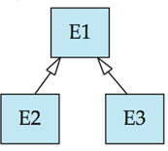
Constraints on Generalizations
Constraint on whether or not entities may belong to more than one lower-level entity set within a single generalization.
  Disjoint
    an entity can belong to only one lower-level entity set
    Noted in E-R diagram by using a single arrow
  Overlapping
    an entity can belong to more than one lower-level entity set
    Using separated arrows

Slide 18
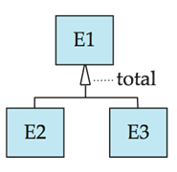
Constraints on Generalizations
Completeness constraint -- specifies whether or not an entity in the higher-level entity set must belong to at least one of the lower-level entity sets within a generalization.
  Total
    An entity must belong to one of the lower-level entity sets
    e.g., a person must be either employee or student
  Partial
    An entity need not belong to one of the lower-level entity sets

Slide 19

Aggregation
Consider the ternary relationship proj_guide, which we saw earlier
Suppose we want to record evaluations of a student by a guide on a project

Slide 20
Aggregation (Cont.)
Relationship sets eval_for and proj_guide represent overlapping information
  Every eval_for relationship corresponds to a proj_guide relationship
  However, some proj_guide relationships may not correspond to any eval_for relationships
  So we can’t discard the proj_guide relationship
Eliminate this redundancy via aggregation
  Treat relationship as an abstract entity
    Abstraction of relationship into new entity
  Allow relationships between relationships

Slide 21

Aggregation (Cont.)
A student is guided by a particular instructor on a particular project
A student-instructor-project combination may have an associated evaluation

Slide 22
E-R Design Decisions
We have to make several decisions, including:
  The use of an attribute or entity set to represent an object
  Whether a real-world concept is best expressed by an entity set or a relationship set
  The use of a ternary relationship versus a pair of binary relationships
  The use of a strong or weak entity set
  The use of specialization/generalization
    contributes to modularity in the design
  The use of aggregation
    can treat the aggregate entity set as a single unit without concern for the details of its internal structure.

Slide 23

Summary of Symbols Used in
E-R Notation

Slide 24
Summary of Symbols Used in
E-R Notation

Slide 25
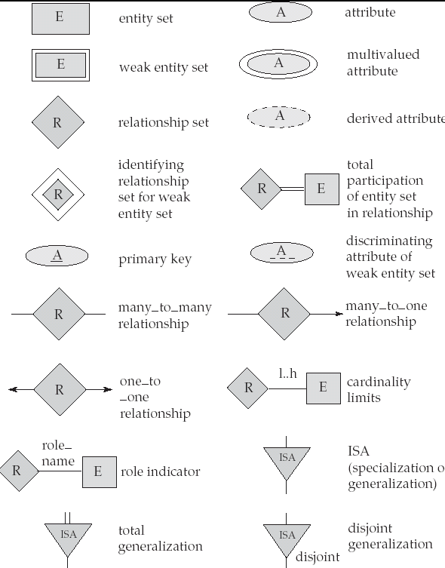
Alternative E-R Notation

Slide 26
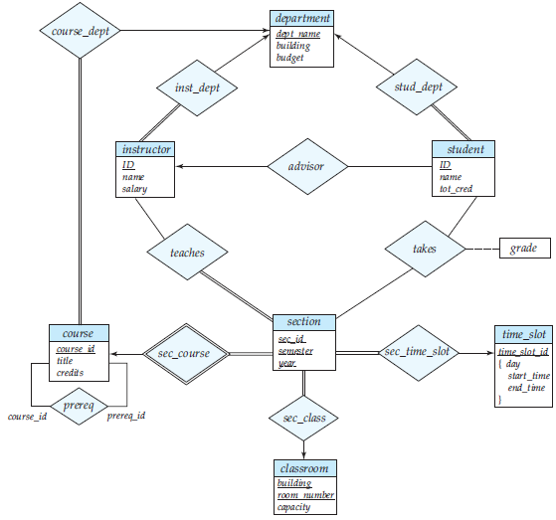
E-R Diagram for a University Enterprise

Slide 27
Reduction to Relation Schemas
Primary keys allow entity sets and relationship sets to be expressed uniformly as relation schemas that represent the contents of the database.
A database which conforms to an E-R diagram can be represented by a collection of schemas.
  For each entity set and relationship set there is a unique schema that is assigned the name of the corresponding entity set or relationship set.
Each schema has a number of columns (generally corresponding to attributes), which have unique names.

Slide 28

Representing Entity Sets as Schemas
A strong entity set reduces to a schema with the same attributes.
A weak entity set becomes a table that includes a column for the primary key of the identifying strong entity set
  Example:
section ( course_id, sec_id, semester, year )

Slide 29
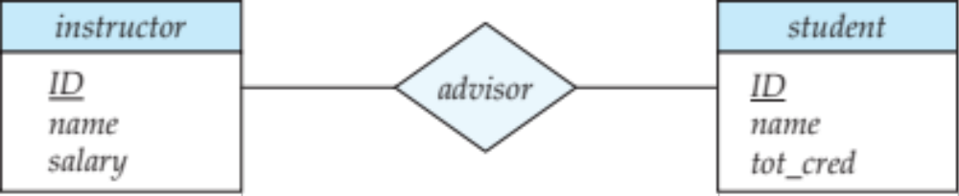
Representing Relationship Sets as Schemas
A many-to-many relationship set is represented as a schema with attributes for the primary keys of the two participating entity sets, and any descriptive attributes of the relationship set.
Example
  schema for relationship set advisor
  advisor = (s_id, i_id)

Slide 30

Redundancy of Schemas
Many-to-one and one-to-many relationship sets that are total on the many-side can be represented by adding an extra attribute to the “many” side, containing the primary key of the “one” side.
If participation is partial on the “many” side, replacing a schema by an extra attribute in the schema corresponding to the “many” side could result in null values.

Slide 31
Redundancy of Schemas (Cont.)
For one-to-one relationship sets, either side can be chosen to act as the “many” side
  i.e. extra attribute can be added to either of the tables corresponding to the two entity sets
No need to represent an identifying relationship set as a schema (in the case of weak entity sets)
  The schema would be redundant.
  Example

Slide 32
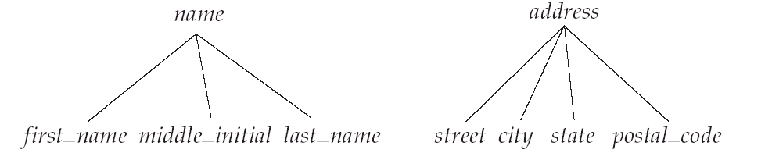
Composite Attributes
Composite attributes are flattened out by creating a separate attribute for each component attribute
  Example: given entity set customer with composite attribute name with component attributes first_name and last_name the schema corresponding to the entity set has two attributes:
  name_first_name and name_last_name
  Another example: composite attribute address with component attribute street and city
    address_street and address_city

Slide 33
Multivalued Attributes
A multivalued attribute M of an entity E is represented by a separate schema EM
  Schema EM has attributes corresponding to the primary key of E and an attribute corresponding to multivalued attribute M
    Example: Multivalued attribute phone_number of instructor is represented by a schema:
    inst_phone= ( ID, phone_number)
  Each value of the multivalued attribute maps to a separate tuple of the relation on schema EM
    For example, an instructor entity with primary key 22222 and phone numbers 456-7890 and 123-4567 maps to two tuples:
    (22222, 456-7890) and (22222, 123-4567)

Slide 34
Representing Specialization via Schemas
Method 1:
  Form a schema for the higher-level entity
  Form a schema for each lower-level entity set; include primary key of higher-level entity set and local attributes
  schema attributes
  person ID, name, street, city
  student ID, tot_cred
  employee ID, salary
  Drawback: getting information about an employee requires accessing two relations
    the one corresponding to the low-level schema and the one corresponding to the high-level schema

Slide 35
Representing Specialization as Schemas
Method 2:
  Form a schema for each entity set with all local and inherited attributes
  schema attributes
  person ID, name, street, city
  student ID, name, street, city, tot_cred
  employee ID, name, street, city, salary
  If specialization is total, the schema for the generalized entity set (person) will not be required to store information.
    Can be defined as a “view” relation for superclass
    View is not able to represent foreign key constraints.
  Drawback: name, street and city may be stored redundantly for people who are both students and employees.

Slide 36
Schemas Corresponding to Aggregation
To represent aggregation, create a schema containing:
  primary key of the aggregated relationship,
  primary key of the associated entity set, with
  any descriptive attributes
For example, to represent aggregation eval_for between relationship proj_guide and entity set evaluation, create a schema…

Slide 37
Schemas Corresponding to Aggregation
  eval_for (s_ID, project_id, i_ID, evaluation_id)
Schema proj_guide would be redundant if we allow null values for evaluation_id

Slide 38
UML
UML: Unified Modeling Language
UML has many components to graphically model different aspects of an entire software system
UML Class Diagrams correspond to E-R Diagram, but several differences.

Slide 39
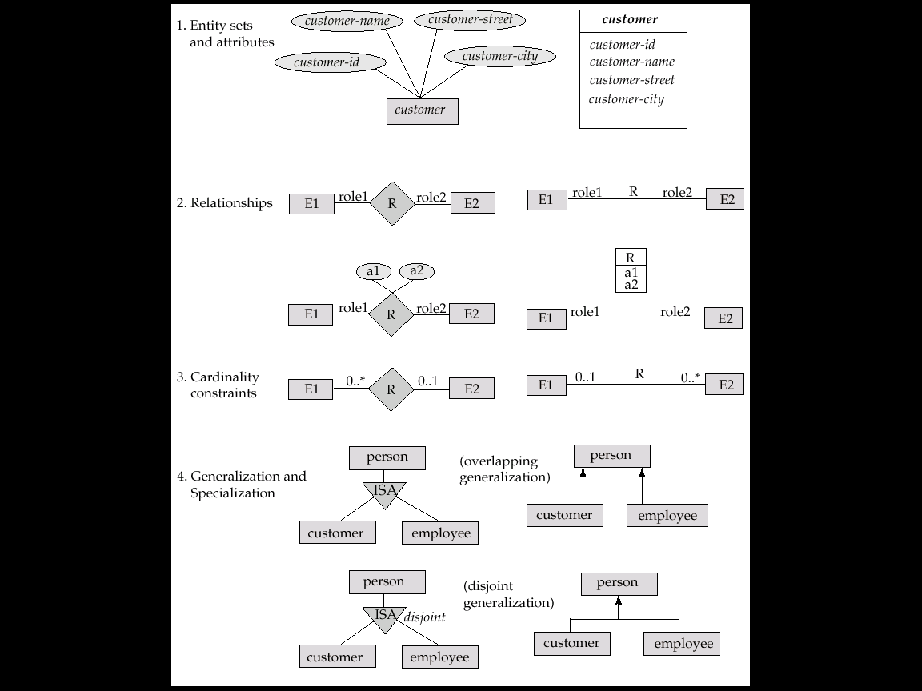
Summary of UML Class Diagram Notation

Slide 40
UML Class Diagrams (Cont.)
Entity sets are shown as boxes, and attributes are shown within the box, rather than as separate ellipses in E-R diagrams.
Binary relationship sets are represented in UML by just drawing a line connecting the entity sets. The relationship set name is written adjacent to the line.
The role played by an entity set in a relationship set may also be specified by writing the role name on the line, adjacent to the entity set.
The relationship set name may alternatively be written in a box, along with attributes of the relationship set, and the box is connected, using a dotted line, to the line depicting the relationship set.
Non-binary relationships drawn using diamonds, just as in ER diagrams

Slide 41
UML Class Diagram Notation (Cont.)
overlapping
disjoint
* Note reversal of position in cardinality constraint depiction
* Generalization can use merged or separate arrows independent of disjoint/overlapping

Slide 42
UML Class Diagrams (Cont.)
Cardinality constraints are specified in the form l..h, where l denotes the minimum and h the maximum number of relationships an entity can participate in.
  Beware: the positioning of the constraints is exactly the reverse of the positioning of constraints in E-R diagrams.
  The constraint 0..* on the E2 side and 0..1 on the E1 side means that each E2 entity can participate in at most one relationship, whereas each E1 entity can participate in many relationships; in other words, the relationship is many to one from E2 to E1.
Single values, such as 1 or * may be written on edges.
  The single value 1 on an edge is treated as equivalent to 1..1, while * is equivalent to 0..*.

Slide 43

ER vs. UML Class Diagrams
*Note reversal of position in cardinality constraint depiction

Slide 44
End of
Lecture 6

